Slide 1


Slide 2
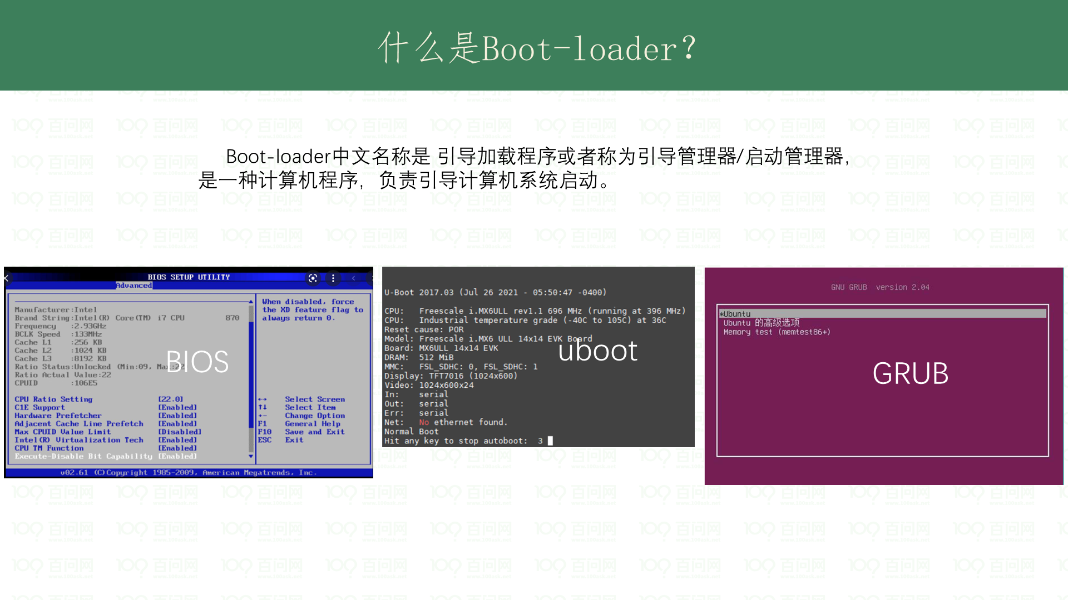
Notes:
https://en.wikipedia.org/wiki/Bootloader

Slide 3
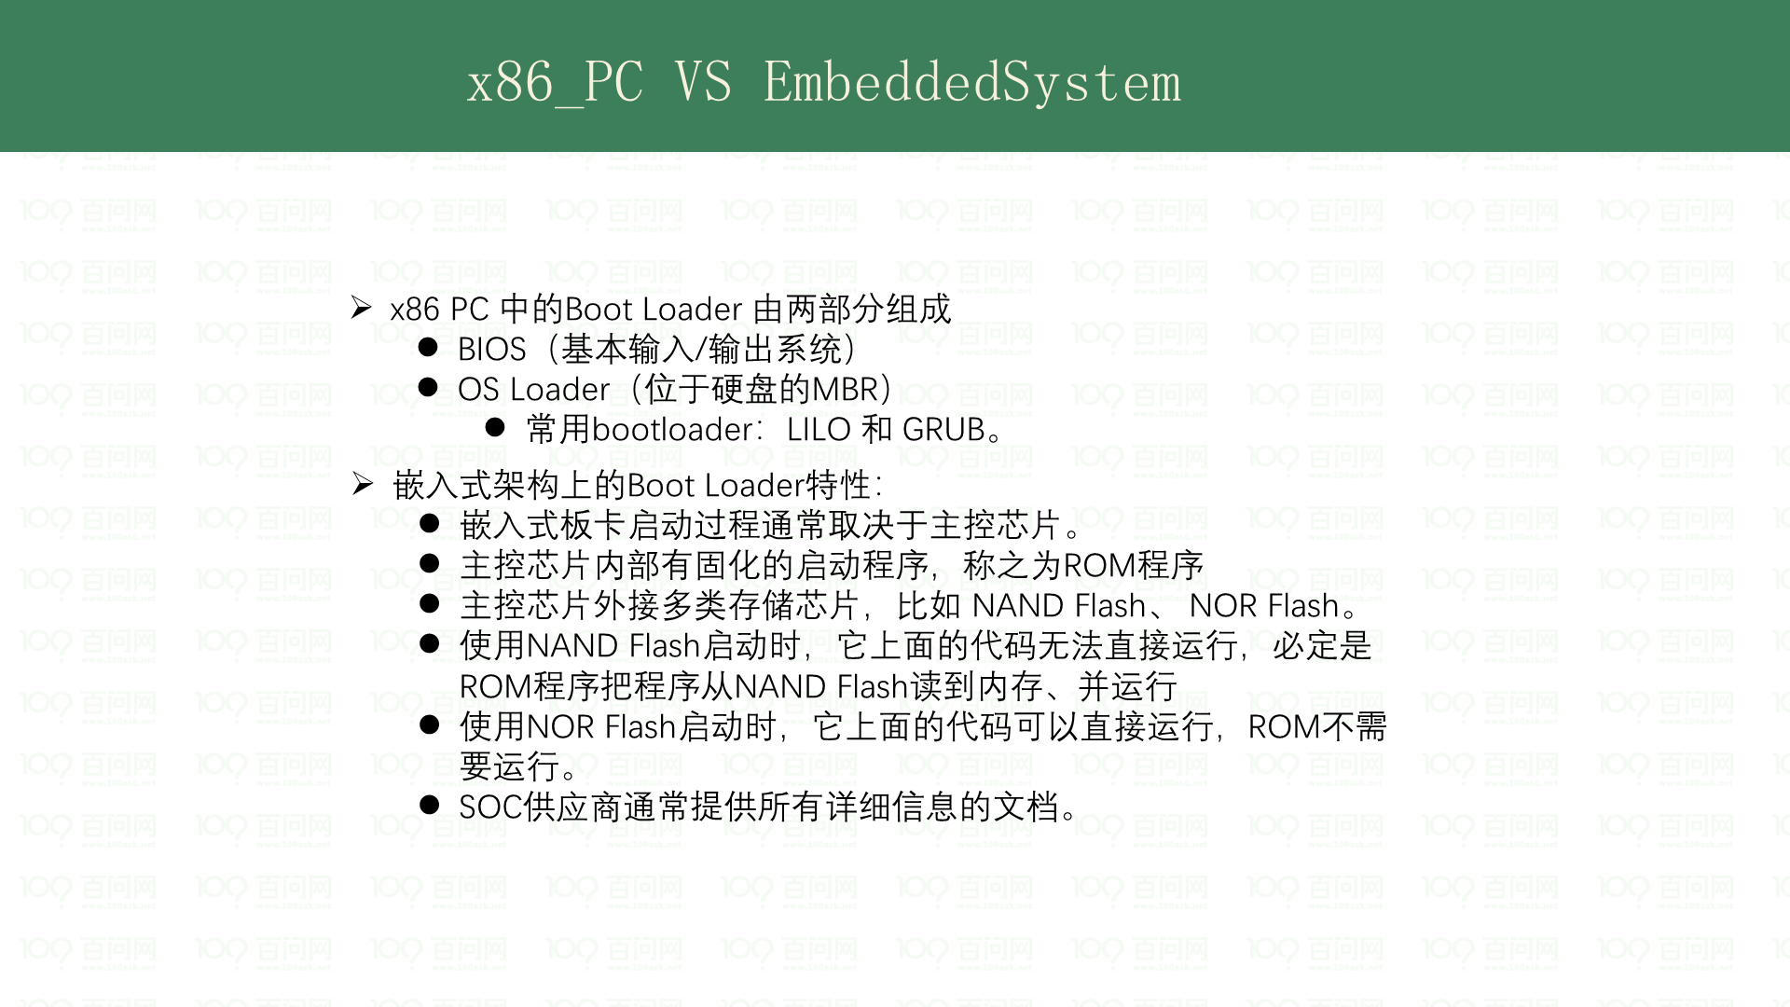

Slide 4
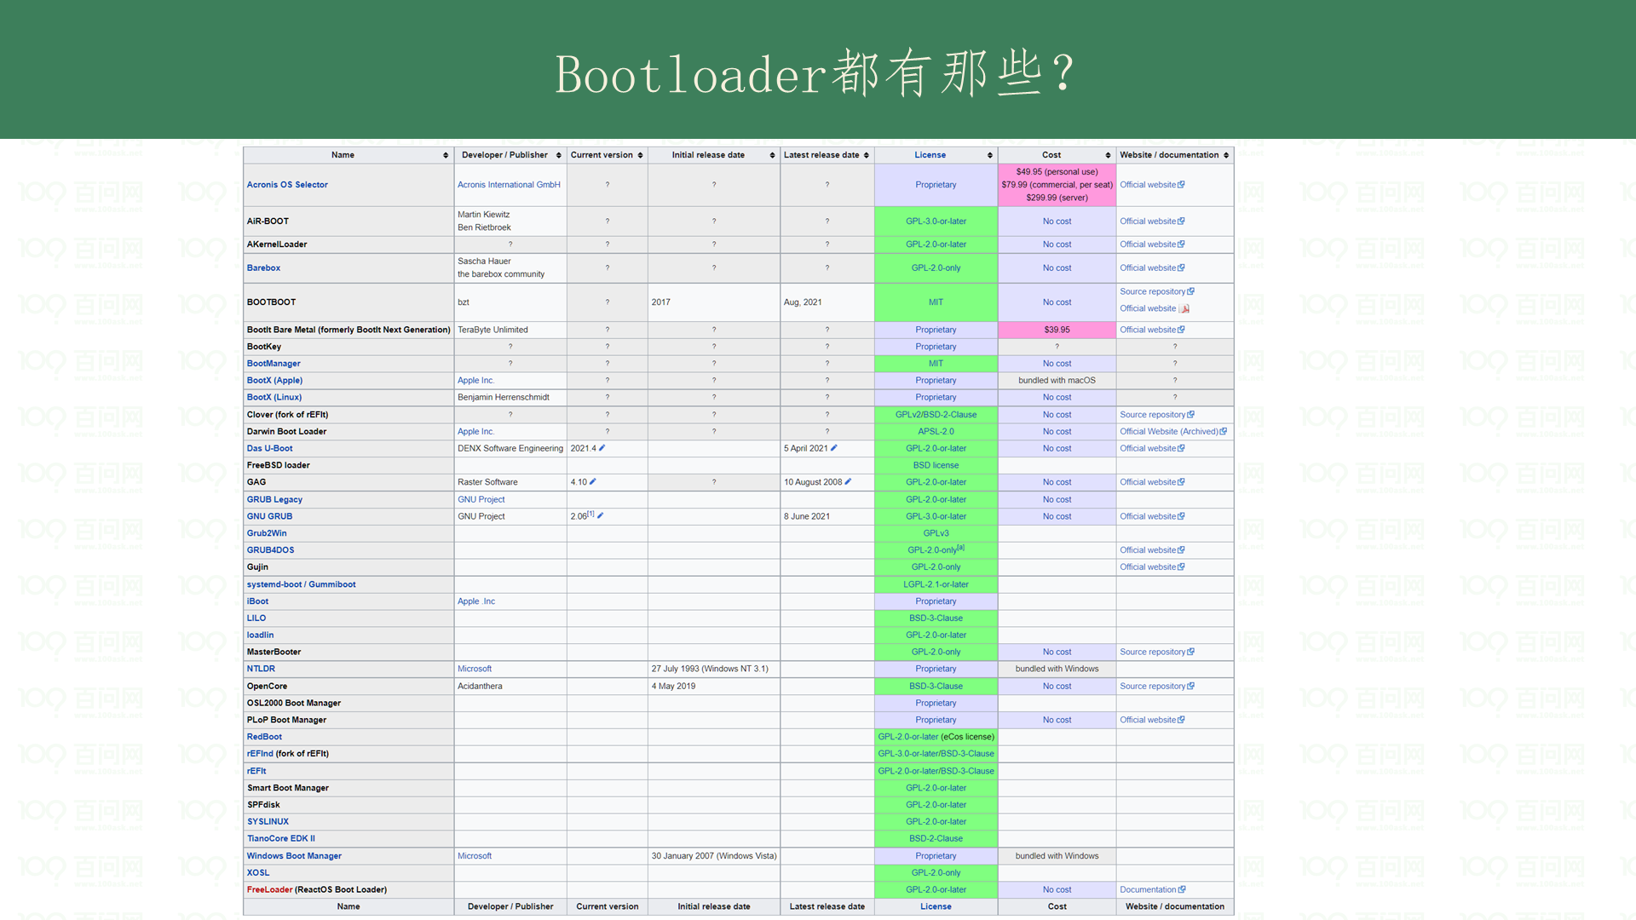
Notes:
参考 https://en.wikipedia.org/wiki/Comparison_of_boot_loaders

Slide 5
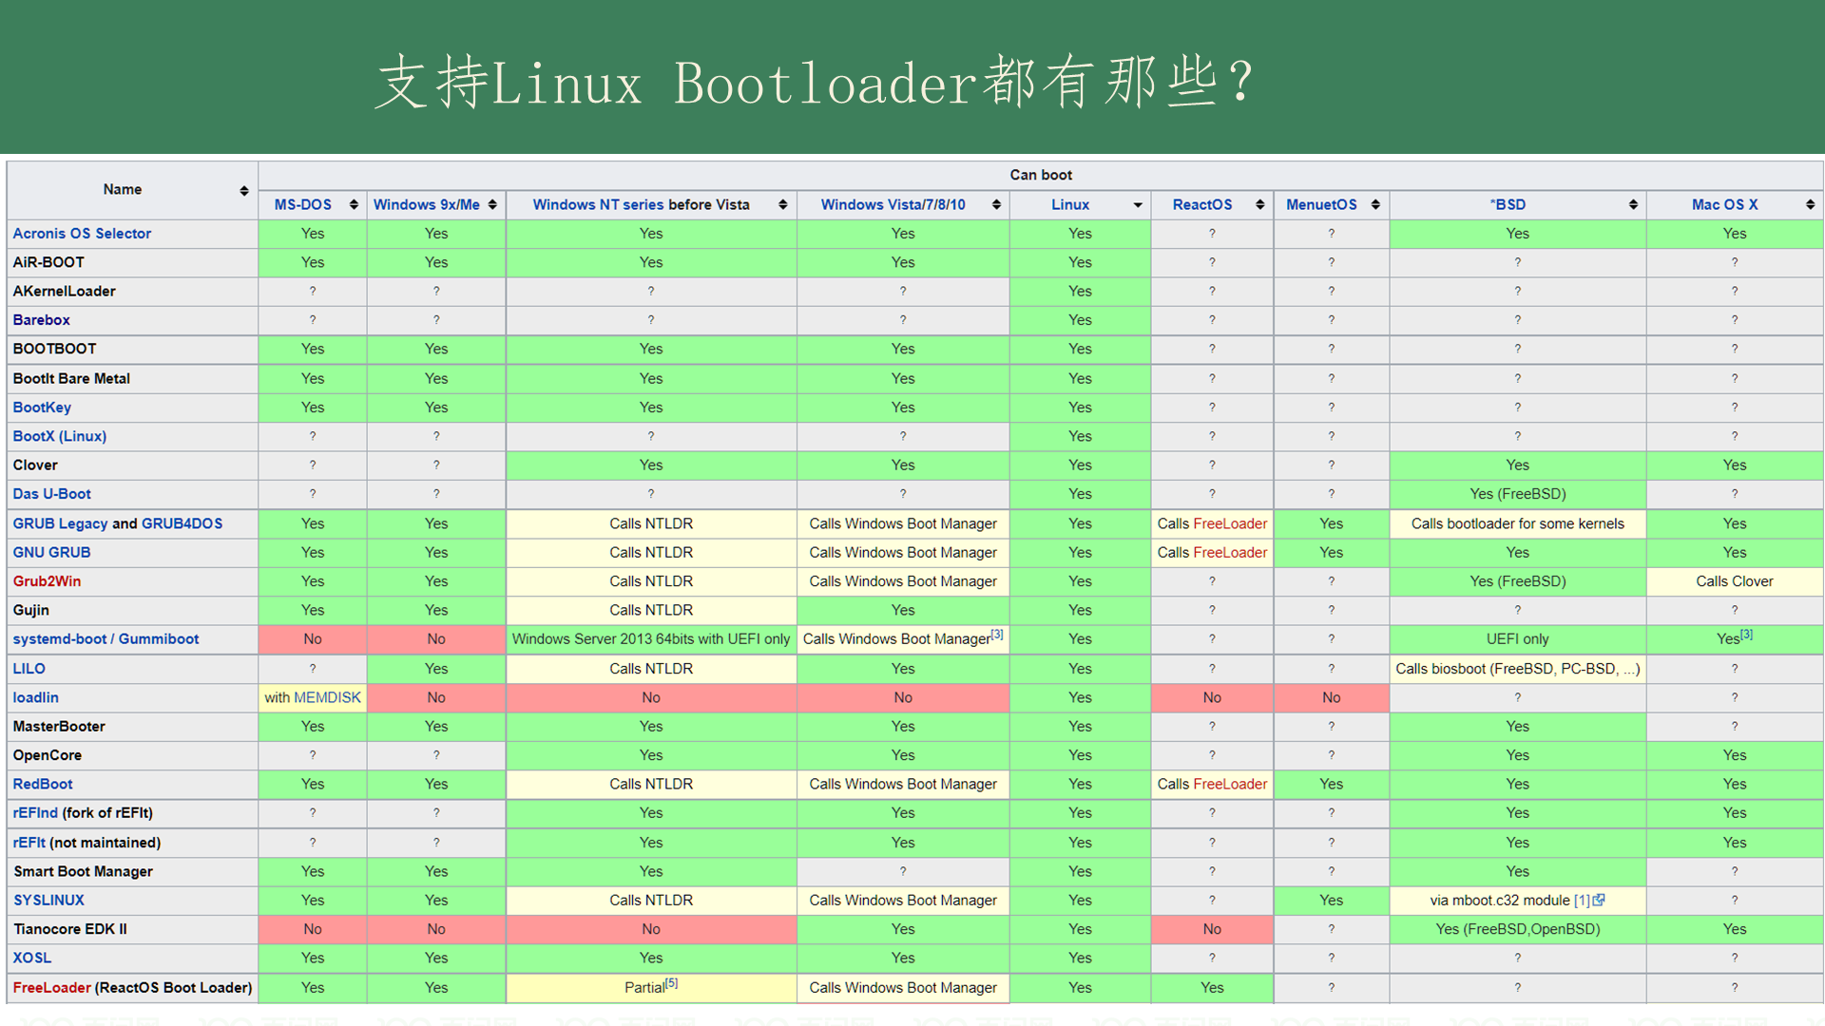
Notes:
参考 https://en.wikipedia.org/wiki/Comparison_of_boot_loaders

Slide 6
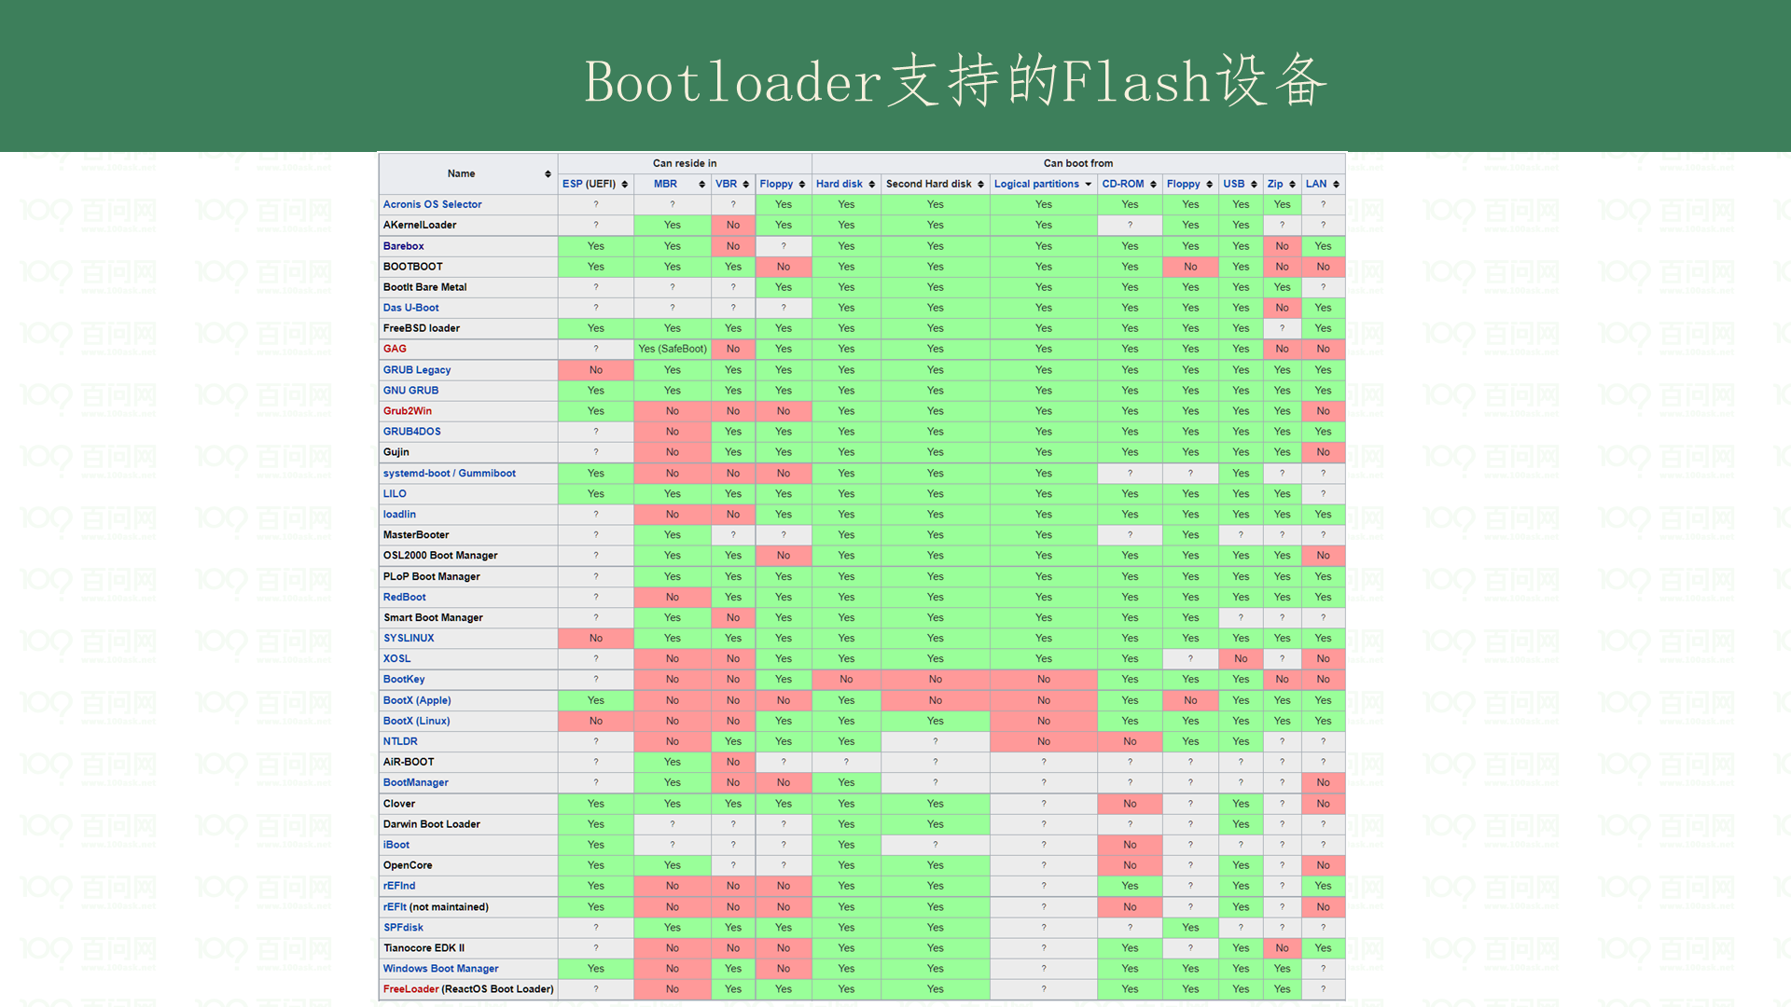

Slide 7
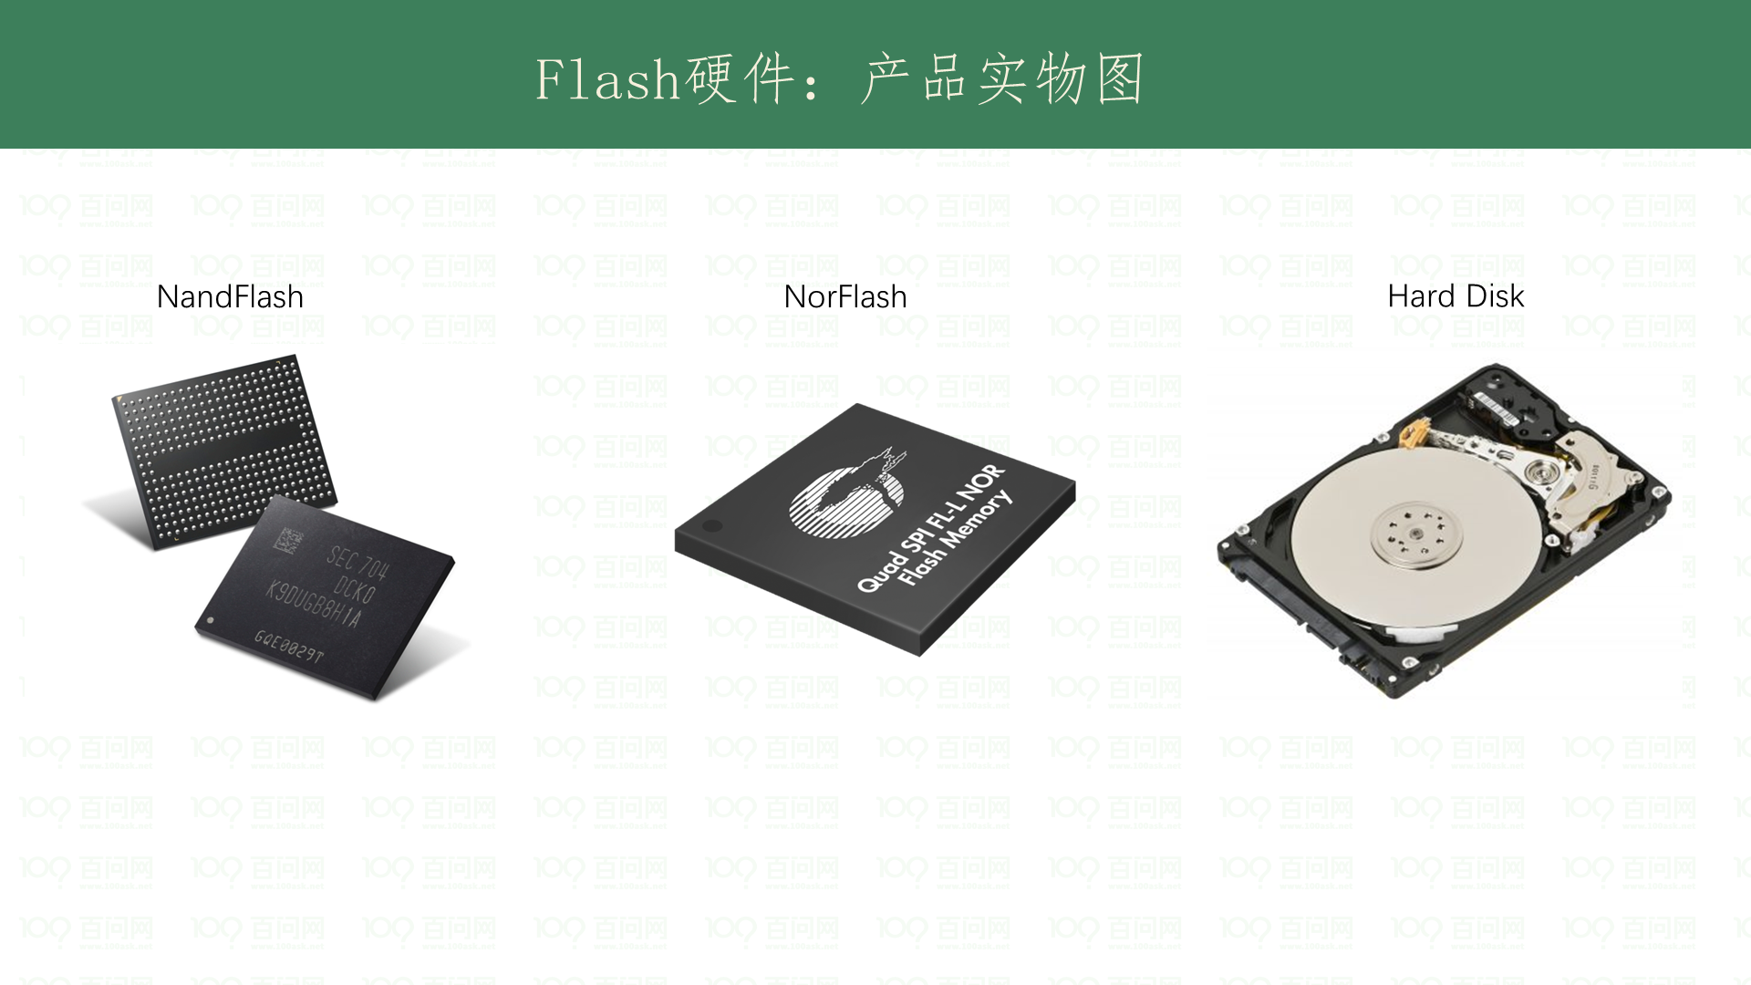

Slide 8
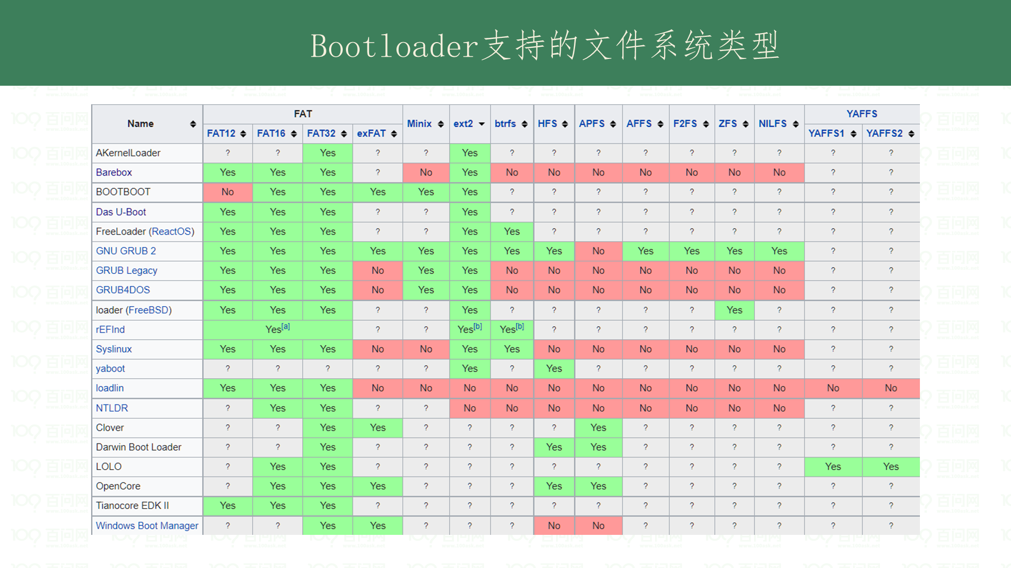

Slide 9
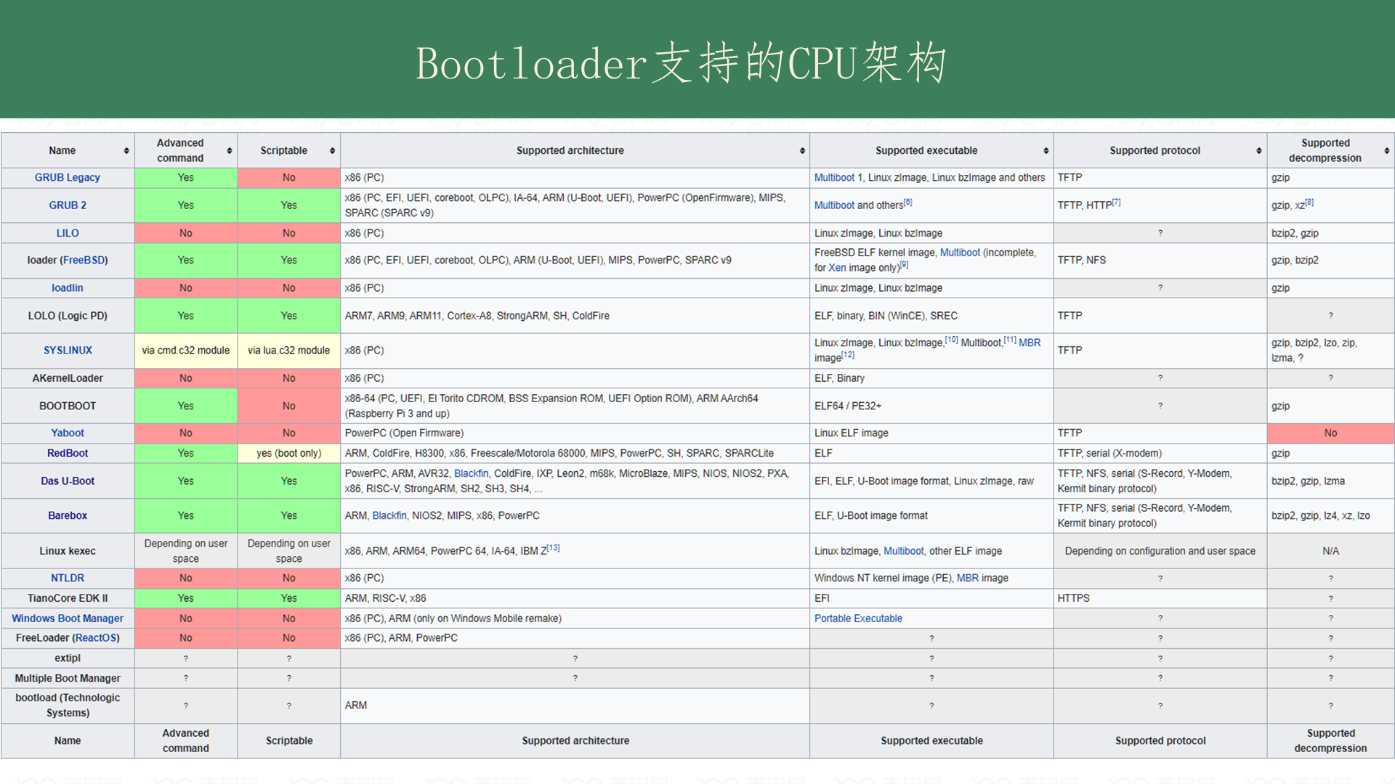

Slide 10
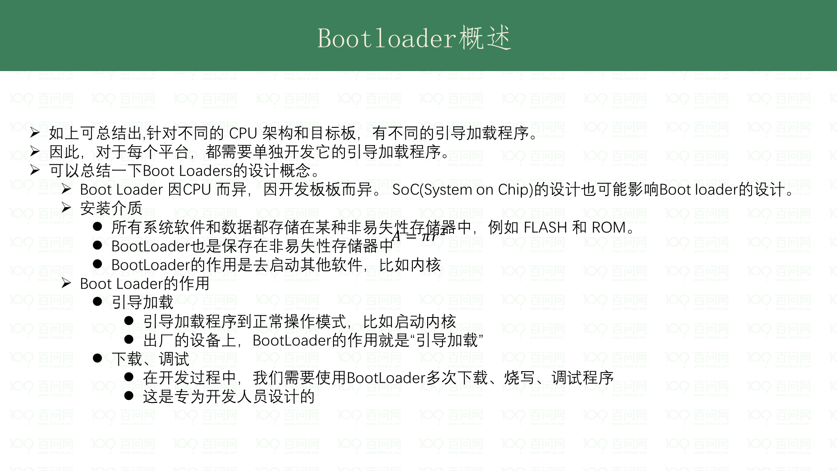

Slide 11
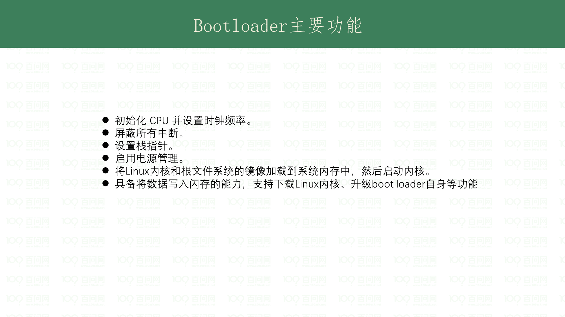
Notes:
https://wiki.st.com/stm32mpu/wiki/Boot_chain_overview#First_stage_boot_loader_-28FSBL-29

Slide 12
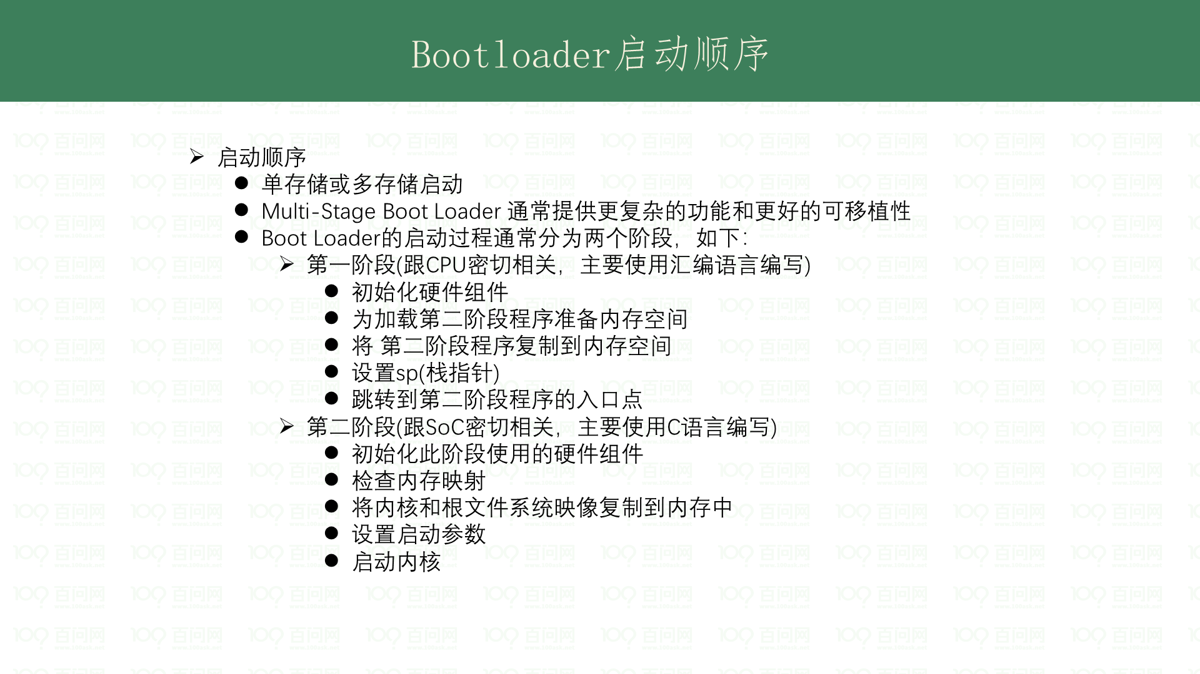
Notes:
https://wiki.st.com/stm32mpu/wiki/Boot_chain_overview#First_stage_boot_loader_-28FSBL-29

Slide 13
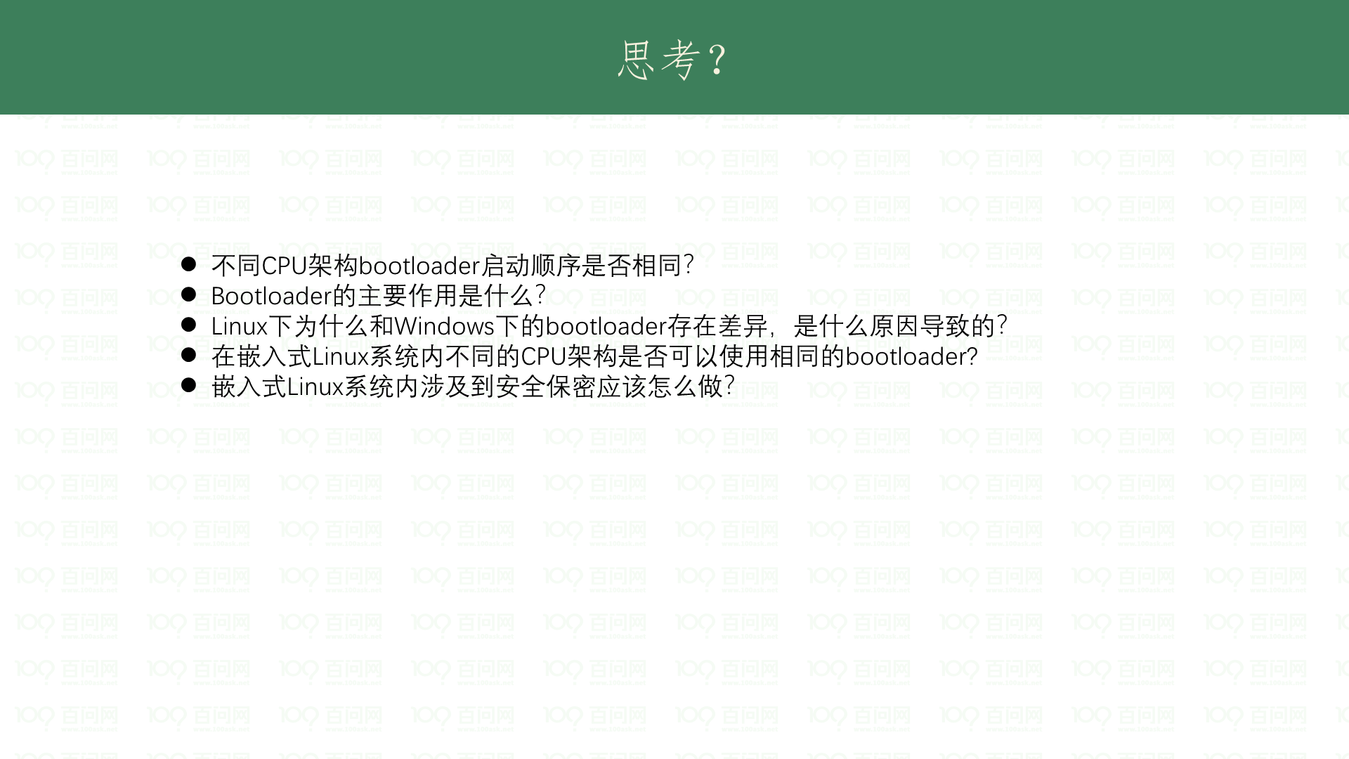
Notes:
https://wiki.st.com/stm32mpu/wiki/Boot_chain_overview#First_stage_boot_loader_-28FSBL-29

Slide 14
